Slide 1
Hybrid Genetic Algorithm to solve TSP
Presented by
Murugappan Meyyappan Murugappan
Advisor: Dr. Devinder Kaur
Panel Member: Dr. Lawrence Miller
Notes:
srtfe

Slide 2
Background and objectives
Background
Traveling salesman Problem (TSP) is a classical optimization problem in the field of computer science.
Given a number of cities and the costs of traveling from any city to any other city, what is the cheapest round-trip route that visits each city exactly once and then returns to the starting city?
Objectives
Use Genetic Algorithm, a search technique used in computing the solutions to optimization and search problems to TSP.
The main objective is to evolve a series of solutions and deriving the best out of them by using genetic operations like inheritance, mutation and crossover.

Slide 3
Outline
TSP – An overview
Genetic Algorithm
Mapping TSP in GA
Hybrid GA
Results & Conclusions

Slide 4

TSP – An overview
TSP (Traveling Salesman Problem) is a classical optimization problem in the field of computer science.
TSP is easy and short to state but difficult to overcome. TSP can be stated in many ways. One statement is, “Given n cities such that there is a direct edge between any two of them, and each edge is assigned a cost, the task is to find the cheapest way of visiting each city exactly once starting and finishing at the same city” as in graph theory. Alternatively we can state the TSP like “Given a number of cities and the costs of traveling from any city to any other city, what is the cheapest round-trip route that visits each city exactly once and then returns to the starting city?”.

Slide 5
TSP – Overview (Cont)
Solving TSP:
Naive approach: One method is to enumerate all possible paths and figure out which one has the shortest distance. This turns out to be a bad idea. For example, if you consider finding the optimal path around cities at unit intervals around the perimeter of a 4X4 square (i.e. 16 cities in a square formation), there are 16! possible routes through all the cities. That's over 20 trillion combinations to choose from! There's got to be a better way....
Heuristic approach: Various approximation algorithms, which quickly yield good solutions with high probability, have been devised. Modern methods can find solutions for extremely large problems (millions of cities) within a reasonable time which are with a high probability just 2-3% away from the optimal solution.( e.g,NN Algorithm, Genetic Algorithm, Simulated Annealing).

Slide 6
TSP – Overview (Cont)
Applications of TSP:
TSP is that it is representative of a larger class of problems known as combinatorial optimization problems.
The TSP problem belongs in the class of combinatorial optimization problems known as NP-complete. Specifically, if one can find an efficient algorithm (i.e., an algorithm that will be guaranteed to find the optimal solution in a polynomial number of steps) for the traveling salesman problem, then efficient algorithms could be found for all other problems in the NP-complete class.
In 1994, Applegate, et. al. solved a traveling salesman problem which models the production of printed circuit boards having 7,397 holes (cities), and, in 1998, the same authors solved a problem over the 13,509 largest cities in the U.S.

Slide 7
Outline
TSP – An overview
Genetic Algorithm
Mapping TSP in GA
Hybrid GA
Results & Conclusions

Slide 8
Genetic Algorithm
A genetic algorithm (or GA) is a search technique used in computing to find true or approximate solutions to optimization and search problems.
Genetic algorithms are categorized as global search heuristics. Genetic algorithms are a particular class of evolutionary algorithms that use techniques inspired by evolutionary biology such as inheritance, mutation, selection, and crossover (also called recombination).
The basic concept of GA is designed to simulate processes in natural system necessary for evolution, specifically those that follow the principles first laid down by Charles Darwin of survival of the fittest. As such they represent an intelligent exploitation of a random search within a defined search space to solve a problem.
In GA, a solution is represented in a Chromosome (genome) format. Then the GA creates a population of solutions randomly and then applies the genetic operators such as mutation, crossover to evolve the next generation of chromosomes (solutions).

Slide 9
Genetic Algorithm (Cont)
Parameters of Genetic Algorithm
  Chromosome: The representation of a valid solution with fixed length in either binary or decimal or other appropriate form.
  Population Size: The Number of chromosomes( solutions) in any generation.
  Generations: The number of generation is the number of times the new population is evolved from the current generation.
  Fitness Function: The fitness function is a function that evaluates the fitness of a particular chromosome( the solution).
  Mutation: A variation operator, which changes the information contained in the genome of a parent according to a given probability distribution.
  Crossover: A mating operator which selects 2 parents and create 2 child chromosomes.
  Mutation Rate & Crossover Rate: The probability rate at which both the operations occur to the current generation.

Slide 10
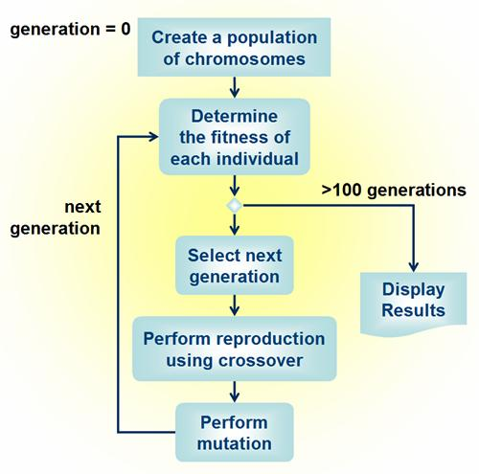
Genetic Algorithm (Cont)

Slide 11
Outline
TSP – An overview
Genetic Algorithm
Mapping TSP in GA
Hybrid GA
Results & Conclusions

Slide 12
Mapping TSP in GA
The first and foremost task is to select the way of representing a solution as a chromosome.
  Binary Chromosome: Not practical due to lot of computation overheads in arriving at legal solutions when a new one is generated.
  Decimal Chromosome: easy to initialize and easy to manipulate for TSP.
The mutation rate is generally very low of the order of 0.01 to 0.001. But in case of decimal chromosomes, the mutation rate goes up to 85%.
The population and the generation are fixed to a number initially and tuned based on the performance.
The number of cities can be kept as a variable which can be changed for various instances.
Each city is randomly generated in 2-D space and the distance between each of them is calculated and stored in a 2-D array.

Slide 13
Mapping TSP in GA (Cont)
The first chromosome in the 1st generation is just the sequence of numbers in ascending order. The other populations of the 1st generation is generated by getting the permutations of the 1st chromosome.
Fitness function: This is the total distance traveled by the salesman for a particular route, which can be found for every chromosome just by following the sequence and looking up the distance between the cities from the distance matrix already created.
The best fitness is the minimum fitness value. For every generation the best fitness is stored in an array. These are finally used in plotting the graph showing the evolution of the best solution over generation.

Slide 14
4 | 6 | 1 | 8 | 5 | 3 | 2 | 7
P1
P2
  index1=2, index2=5 Crossover
  tmp1 tmp2
  Initial Child1
Initial Child2
Final Child1
Final Child2
3 | 2 | 8 | 6 | 4 | 7 | 1 | 5
6 | 1 | 8 | 5
2 | 8 | 6 | 4
 | 2 | 8 | 6 | 4
 | 6 | 1 | 8 | 5
1 | 2 | 8 | 6 | 4 | 5 | 3 | 7
3 | 6 | 1 | 8 | 5 | 2 | 4 | 7

Slide 15
Mutation
Chromosome C1
ndx1=3 ndx2=7
  Window
Reversed Window
New Chromosome
3 | 6 | 1 | 8 | 5 | 2 | 4 | 7
1 | 8 | 5 | 2 | 4
4 | 2 | 5 | 8 | 1
3 | 6 | 4 | 2 | 5 | 8 | 1 | 7

Slide 16
Figure 3: Crossover in TSP-GA
The Mutation operation is done by selecting mutation rate number of chromosomes and selecting some random window and flipping the elements inside the window..
P1
ndx1=2 ndx2=5
WINDOW
NEW P1
3 | 2 | 8 | 6 | 4 | 7 | 1 | 5
2 | 8 | 6 | 4
3 | 4 | 6 | 8 | 2 | 7 | 1 | 5

Slide 17
Outline
TSP – An overview
Genetic Algorithm
Mapping TSP in GA
Hybrid GA
Results & Conclusions

Slide 18
Hybrid GA
The hybrid genetic algorithm is interested at faster convergence and a better point of convergence.
The NN algorithm is combined with the Pure GA to evolve finer solutions.

Slide 19
Types of Hybrid GA
Completely filling the 1st Gen Population with NN solutions
Partially filling the 1st Gen Population with NN solutions

Slide 20
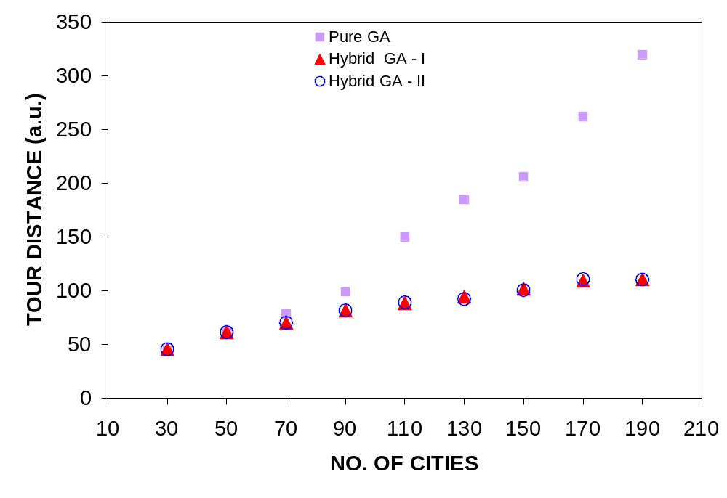
Results

Slide 21
Outline
TSP – An overview
Genetic Algorithm
Mapping TSP in GA
Hybrid GA
Results & Conclusions

Slide 22
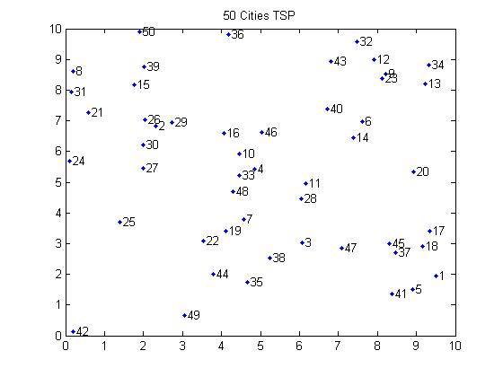
Results
For N=50 cities, P=100 chromosomes per generation and G=500 generations, the results are simulated and show below.
    INITIAL GEOGRAPHICAL LOCATION OF CITIES
Notes:
Suitable approach towards modeling auxetic behavior in random fiber networks has been done.
Stiffness: The ability of material to resist elastic deformation. It is characterized by the Young's modulus.

Slide 23
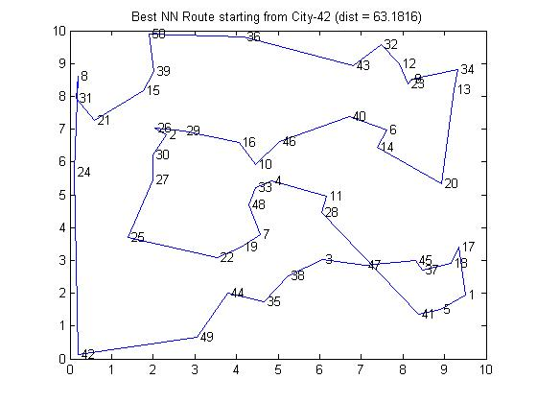
Results (Cont)
The Best NN Route is shown below:
Notes:
Suitable approach towards modeling auxetic behavior in random fiber networks has been done.
Stiffness: The ability of material to resist elastic deformation. It is characterized by the Young's modulus.

Slide 24
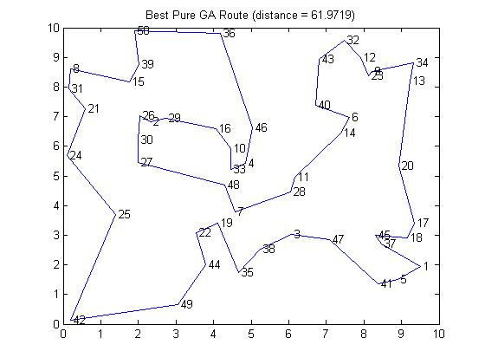
Results (Cont)
The Best Pure GA Route is shown below:
Notes:
Suitable approach towards modeling auxetic behavior in random fiber networks has been done.
Stiffness: The ability of material to resist elastic deformation. It is characterized by the Young's modulus.

Slide 25
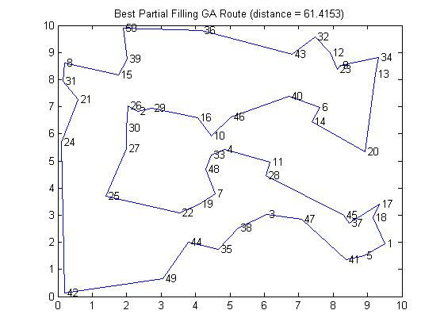
Results (Cont)
The Best Partially Filled GA Route is shown below:
Notes:
Suitable approach towards modeling auxetic behavior in random fiber networks has been done.
Stiffness: The ability of material to resist elastic deformation. It is characterized by the Young's modulus.

Slide 26

Results (Cont)
The Best Completely Filled GA Route is shown below:
Notes:
Suitable approach towards modeling auxetic behavior in random fiber networks has been done.
Stiffness: The ability of material to resist elastic deformation. It is characterized by the Young's modulus.

Slide 27
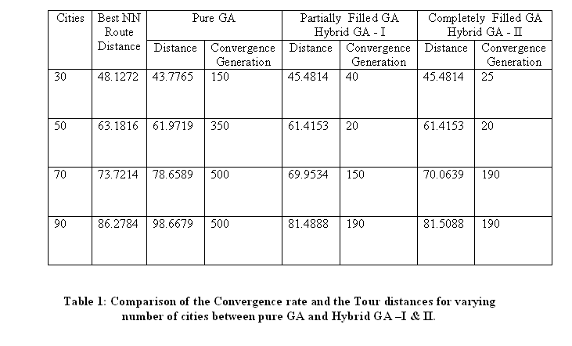
Results (Cont)
Comparison of the performance of the different Hybrid GAs
Notes:
Suitable approach towards modeling auxetic behavior in random fiber networks has been done.
Stiffness: The ability of material to resist elastic deformation. It is characterized by the Young's modulus.

Slide 28
Conclusion & Future Work
The ideas and concepts discussed here for TSP is not only used for TSP. It can be applied for any combinatorial optimization problems where we use decimal chromosomes.
The results we got shows that we can improve the performance of a solution for combinatorial problem by using Hybrid GA.
Future Work:
  This Hybrid GA with decimal chromosomes can be used anywhere where the decimal chromosome solution applies and can be modified and tuned for better performances.
  The HILL Climbing can be done to check the performance and avoiding local maxima.
Notes:
Suitable approach towards modeling auxetic behavior in random fiber networks has been done.
Stiffness: The ability of material to resist elastic deformation. It is characterized by the Young's modulus.

